Slide 1
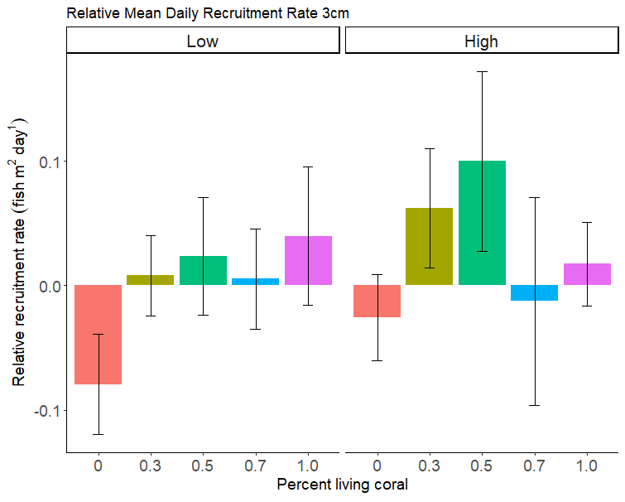
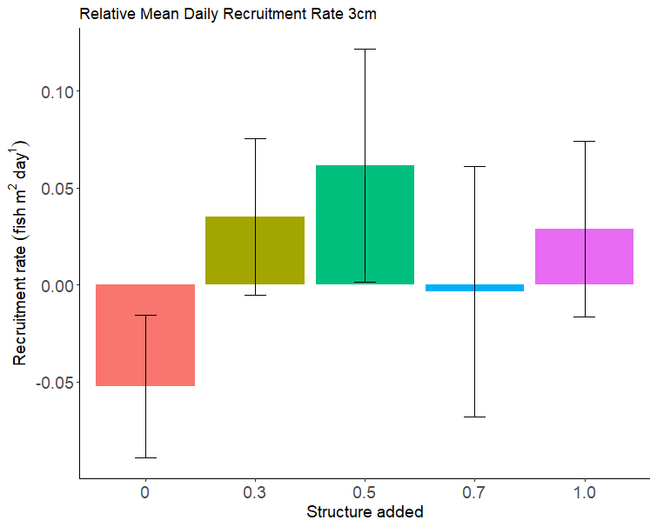
Relative recruitment rate (whole study period)
-
Notes:
Rate: normal dist, lmm → permutations for random effects (time + space)

Slide 2
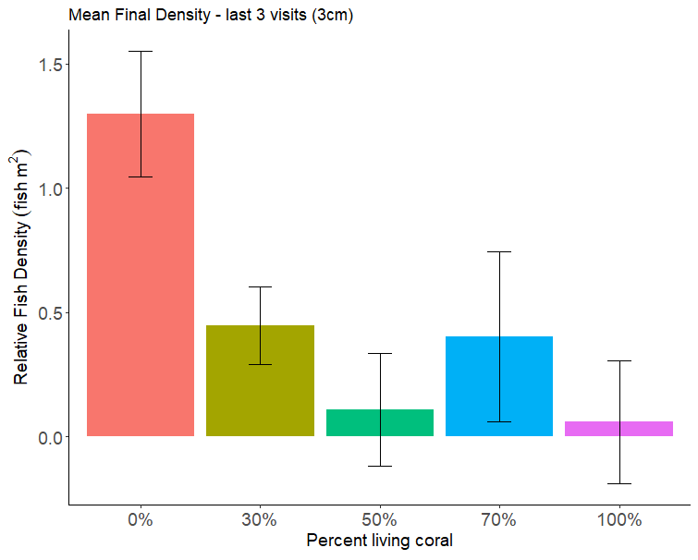
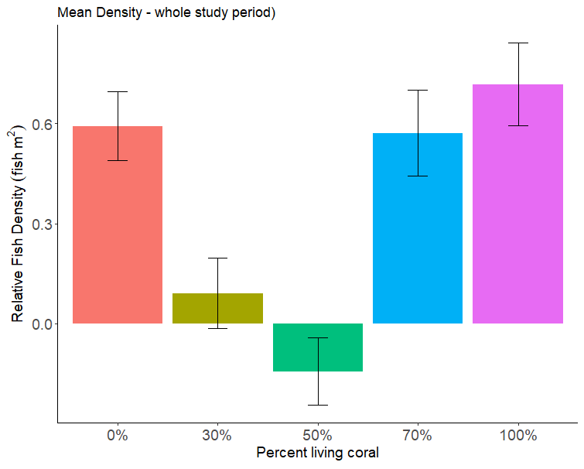
Relative density: last 3 visits, vs whole study period
Add mean density as metric that captures saturation density?

Slide 3
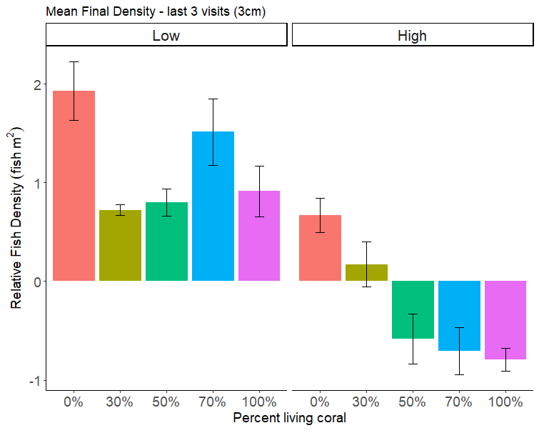
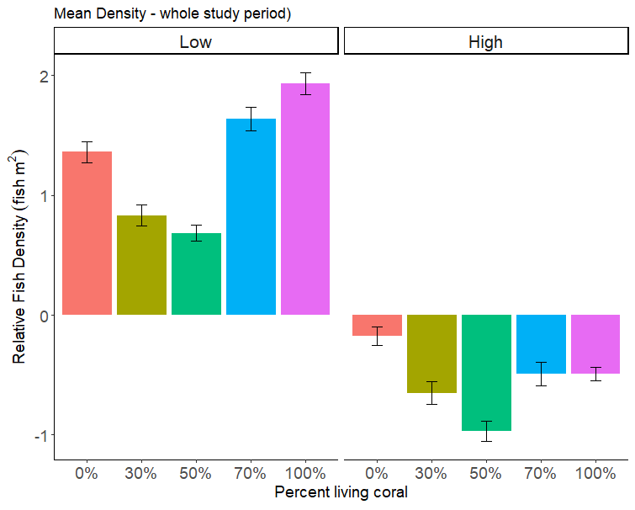
Relative density: last 3 visits, vs whole study period
Add mean density as metric that captures saturation density?
- Makes sense to use 3cm and smaller
Supp -> *
Would need define how mean of last 3 differs then → (or drop)
Ecological time-scale of retaining?
Filter for 4-6cm fish and see

Slide 4
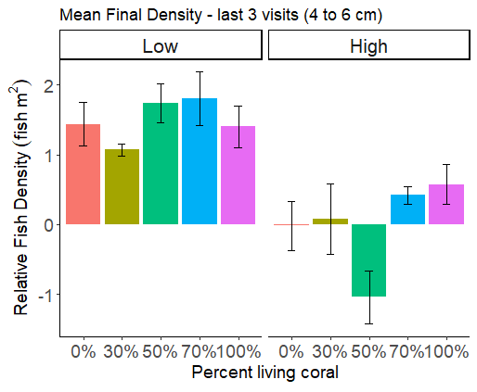
3cm → recruit saturation density
4-6cm → recruit retention
Notes:
Final 3 4-6 (does plot matter -> check for random effect) → aov or glm (check structure)
3cm max saturation → maybe plot as random, vist (day_since_outplanting + plot_grid) as random
Density: poisson / neg-binomial distribututions →
3cm (whole study period) : visit AND plot as random
4-6cm (average of last 3) : no need for visit to be random (just see if plot needs to be included as random)

Slide 5
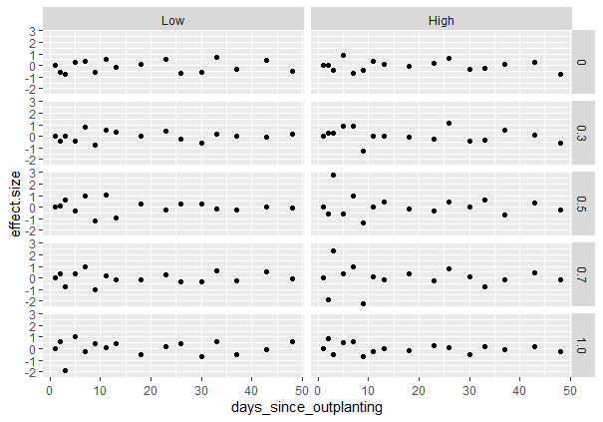
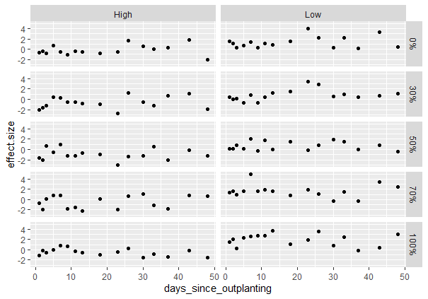
Make sample size different across sampling time?
Relative rate
Relative density

Slide 6
# NEXT:
# 1) could also try dropping first survey for "training" effects (or reducing samples in first half since there are more) *training with standardizing -> sup
# 2) could do generalized lm for non-linear relationships (i.e. specify poisson --> but these data don't look that non-normal, it's the variance that's the issue)
# 3) could do a generalized least squares estimation ( allows different variances)
# 4) could consider doing a mixed effects model with observer and plot as random effects? take into account spatial structure → check for block (plot) as random (cluster|plot)
Notes:
Rate: same intercept? *or allow both to vary, could compare and check in model selection AICc →
* Lmm *if plot or visit not important → back to generalized lm
Density:
* Glmm → poisson/neg binom

